Slide 1

Introduction: Security, Security goals, cyberspace, cybercrime, cybersecurity, Security risks, Identity theft, Countermeasures
Week 1
Semester 1, 2025
Dr. Farshid Keivanian

Slide 2
Unit Overview
Welcome to Cybersecurity Essentials! In this unit, we will learn the basic ideas and skills you need to protect networks, systems, and data from cyber threats. We’ll explore what security means, the goals we aim for (like confidentiality, integrity, and availability), and the many challenges of our interconnected world—from cybercrime and identity theft to how we can protect ourselves with countermeasures.

Slide 3
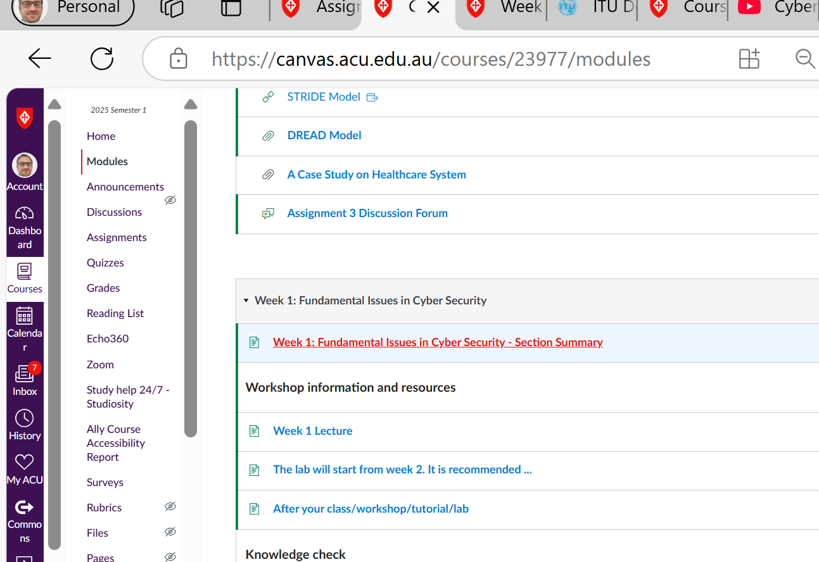
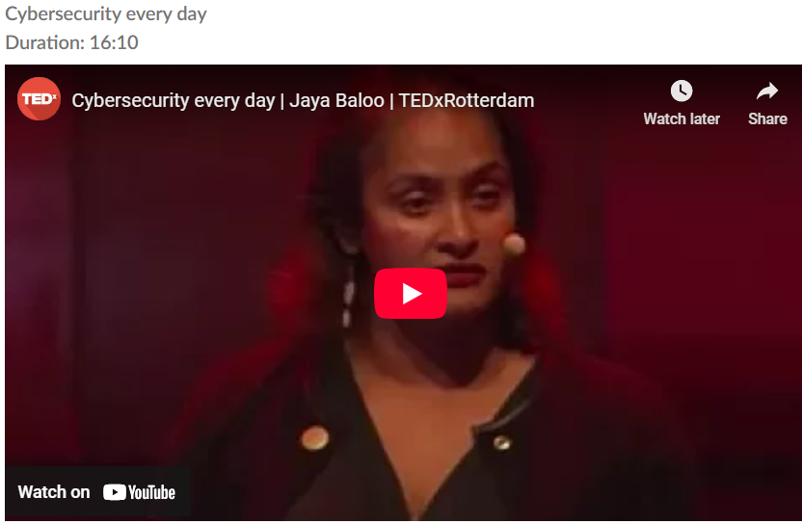
Unit Overview
Remember what the video highlighted:
Cybersecurity isn’t just about keeping your phone or computer safe—it affects every connected device around you.

Slide 4
Unit Overview
Staying updated, understanding risks, and using simple protective measures can help keep you safe in this digital world.

Slide 5
Unit Overview
The goal is to help you see how everyday actions (like updating your device) are key to defending against attacks.

Slide 6
Lecture 1: Introduction to Cybersecurity
Main Topics:
What is Security?
Security Goals
Cyberspace, Cybercrime, and Cybersecurity
Security Risks
Identity Theft
Countermeasures

Slide 7
What is Security?
Discussion Questions:
How do you define security in everyday life?
Security in everyday life means being free from harm, danger, or threats. It includes personal safety, financial security, data protection, and feeling safe in our surroundings.

Slide 8
What is Security?
Discussion Questions:
Can you share an example when you felt secure or insecure (online or offline)?
Secure: Using two-factor authentication (2FA) to protect my email and bank account makes me feel secure online.
Insecure: Receiving a phishing email pretending to be my bank made me feel insecure because it could have stolen my personal information.

Slide 9
Hands-on Activity:
Brainstorming Session: In small groups, list everyday things that keep you safe (locks, passwords, alarms). Then, share why these measures are important.
Examples:
Physical security: Locks, doors, fences, security cameras, alarms.
Digital security: Passwords, two-factor authentication, antivirus software, encryption.
Personal safety: Seatbelts, helmets, smoke detectors, emergency contacts

Slide 10
Hands-on Activity:
Brainstorming Session: In small groups, list everyday things that keep you safe (locks, passwords, alarms). Then, share why these measures are important.
Locks and alarms prevent theft and unauthorized access.
Passwords and encryption protect personal data from hackers.
Seatbelts and helmets reduce injury risks in accidents.
Smoke detectors warn us of fires, saving lives.

Slide 11
Problem-Solving Question: Compounding Risk Reduction in Security Processes
If a security process reduces risk by 15% each time it’s applied and a business uses 4 independent security processes, what is the overall risk reduction? (Hint: Assume each process leaves 85% of the risk remaining, so calculate 0.85⁴ and then determine the percentage reduction.)

Slide 12
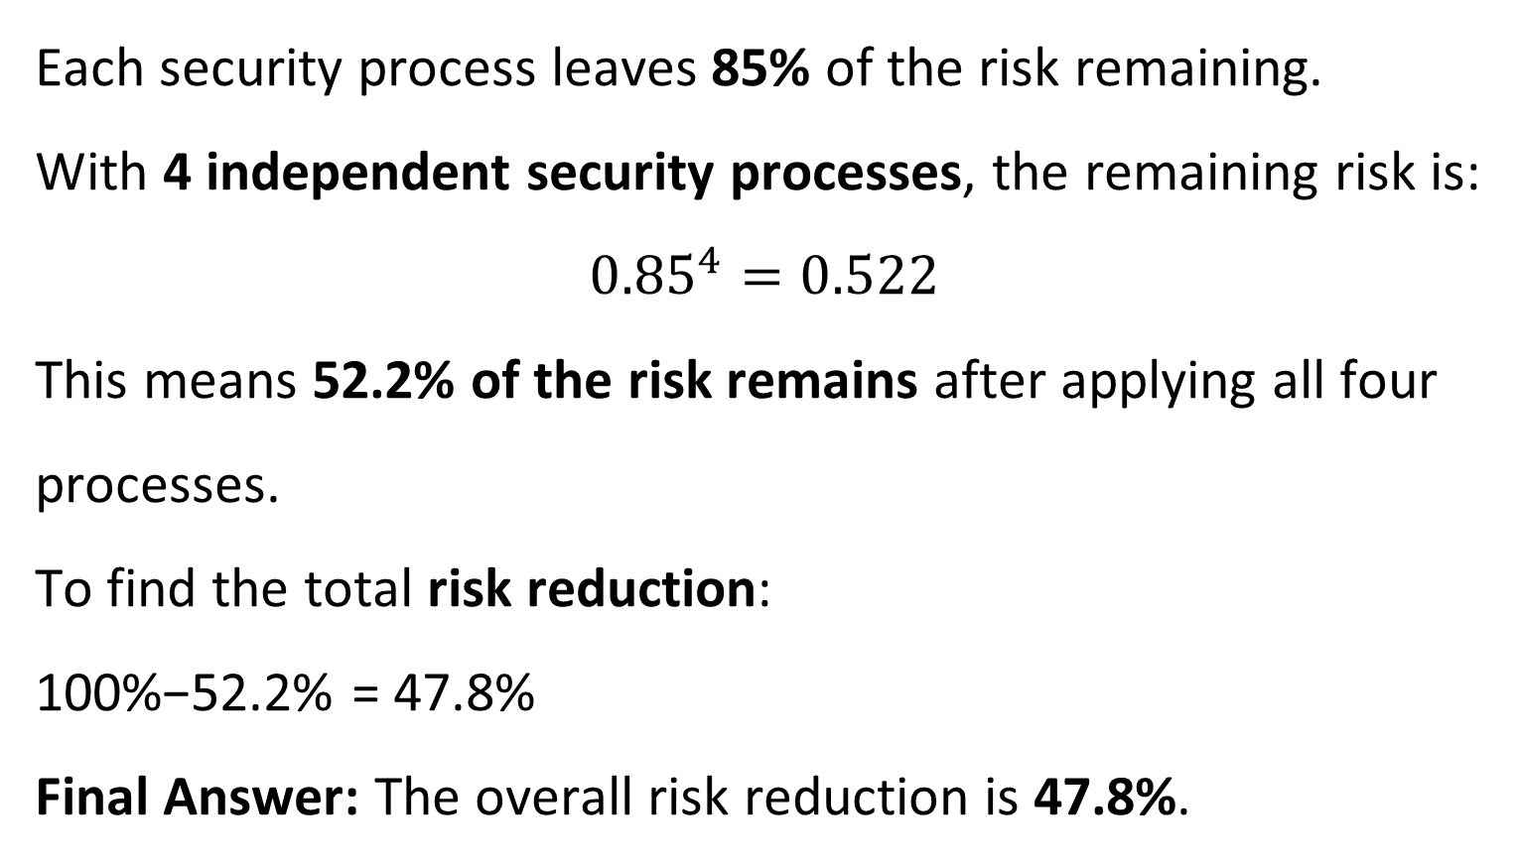
Problem-Solving Question: Compounding Risk Reduction in Security Processes
Each security process leaves 85% of the risk remaining. With 4 independent security processes, the remaining risk is:
$${0.85}^{4}=0.522$$
This means 52.2% of the risk remains after applying all four processes.
To find the total risk reduction:
100%−52.2% = 47.8%
Final Answer: The overall risk reduction is 47.8%.

Slide 13
Security Goals
Discussion Question:
What do you think are the main goals of security?
Confidentiality – Keep information private and accessible only to the right people.
Integrity – Ensure data is accurate and not changed by unauthorized users.
Availability – Make sure systems and data are available when needed.
Authentication – Verify the identity of users and devices.
Non-repudiation – Ensure actions cannot be denied after they are performed.

Slide 14
Security Goals
Discussion Question:
Why is it important to protect information (e.g., keeping it confidential and intact)?
Privacy – Prevents unauthorized access to personal and sensitive data.
Trust – Builds confidence in businesses, governments, and online services.
Integrity – Ensures data is accurate and not changed by hackers.
Security – Protects against fraud, identity theft, and cyberattacks.
Compliance – Meets legal and industry regulations to avoid penalties

Slide 15
Security Goals
Hands-on Activity:
Demonstration: Use a physical lock and key to show how access is controlled. Then, relate this to online security (like passwords protecting accounts).
Demonstration: Show how a physical lock and key work to control access. Only the right key can unlock it.
Discussion: Relate this to online security.
A key is like a password – it grants access.
A lock is like an account or system – it protects valuable information.

Slide 16
Security Goals
Hands-on Activity:
Demonstration: Use a physical lock and key to show how access is controlled. Then, relate this to online security (like passwords protecting accounts).
If someone has the wrong key (or password), they can’t get in.
Takeaway: Just like a strong lock keeps things safe, strong passwords protect online accounts.

Slide 17
Problem-Solving: Measuring Security Effectiveness: Understanding Risk Reduction
Example: A company installs security cameras and alarm systems to reduce theft. However, despite these measures, theft still happens 5% of the time. What is the effectiveness of their security system?
Solution:
The security system prevents theft 95% of the time.
Effectiveness = 95% (since theft occurs 5% of the time).

Slide 18
Problem-Solving: Measuring Security Effectiveness: Understanding Risk Reduction
Example: A company installs security cameras and alarm systems to reduce theft. However, despite these measures, theft still happens 5% of the time. What is the effectiveness of their security system?
Takeaway: No system is 100% secure, but improving security measures can reduce risks significantly.

Slide 19
Cyberspace, Cybercrime, and Cybersecurity
Discussion Question: How would you describe cyberspace in your own words?
Cyberspace is the digital world where people connect, share information, and interact using the internet, computers, and networks.

Slide 20
Cyberspace, Cybercrime, and Cybersecurity
Discussion Question: What are some examples of cybercrime you have heard about in the news?
Hacking – Unauthorized access to systems.
Phishing – Fake emails tricking people into giving passwords.
Ransomware – Hackers locking data and demanding money.
Identity theft – Stealing personal information to commit fraud.

Slide 21
Cyberspace, Cybercrime, and Cybersecurity
Discussion Question: How does cybersecurity differ from cybercrime?
Cybersecurity is about protecting data, systems, and networks from attacks.
Cybercrime is illegal activities like hacking, fraud, and spreading viruses. Cybersecurity prevents cybercrime.

Slide 22
Cyberspace, Cybercrime, and Cybersecurity
Hands-on Activity:
News Analysis: Have students find a recent news article about a cybercrime. In groups, discuss what went wrong and how it might have been prevented.
Find a News Article – Students search for a recent cybercrime case.
Group Discussion:
What went wrong? (How was the attack carried out?)
What were the consequences? (Who was affected?)
How could it have been prevented? (Stronger passwords, security updates, awareness, etc.)
Class Sharing – Groups present key takeaways.
Goal: Learn real-world cyber threats and how to prevent them.

Slide 23
Cyberspace, Cybercrime, and Cybersecurity
Problem-Solving Question: Understanding Incident Rates: Measuring Cybersecurity Risks
Example: A company has 1,000 connected devices. In one month, 10 devices experience a cyber incident. What percentage of devices were affected?
Takeaway: Even a small incident rate can be risky in large systems. Strong security measures help reduce threats.
Solution:
Affected devices = 10
Total devices = 1,000
Incident rate (%) = (10 / 1000) × 100 = 1%

Slide 24
Security Risks
Discussion Questions:
What do you think are common risks when you are online (e.g., phishing, weak passwords)?
Phishing – Fake emails or websites tricking users into giving personal information.
Weak Passwords – Easy-to-guess passwords make accounts vulnerable to hacking.
Malware & Viruses – Harmful software that can steal data or damage devices.
Identity Theft – Cybercriminals stealing personal details for fraud.
Public Wi-Fi Risks – Unsecured networks allowing hackers to intercept data.
Social Engineering – Manipulating people to reveal confidential information.

Slide 25
Security Risks
Discussion Questions:
What do you think are common risks when you are online (e.g., phishing, weak passwords)?
Takeaway: Being aware of these risks helps protect personal data and stay safe online.

Slide 26
Security Risks
Discussion Questions:
How might these risks affect your daily activities at school or work?
Phishing – You might lose access to school or work emails if tricked by a fake login page.
Weak Passwords – Hackers could access your accounts, leading to data loss or misuse.
Malware & Viruses – Infected devices may slow down or lose important files.
Identity Theft – Someone could use your personal details to commit fraud.
Public Wi-Fi Risks – Sensitive information, like login credentials, could be stolen.
Social Engineering – Cybercriminals might manipulate you into sharing confidential data.

Slide 27
Security Risks
Discussion Questions:
How might these risks affect your daily activities at school or work?
Takeaway: Online risks can disrupt learning, work, and personal security. Staying alert helps prevent cyber threats.

Slide 28
Security Risks
Hands-on Activity:
Risk Assessment Exercise: Present a list of everyday online actions (clicking on links, using public Wi-Fi) and ask students to rate each one on a risk scale from 1 (low) to 5 (high). Discuss the ratings as a class.

Slide 29
Security Risks
1. Present Everyday Online Actions:
Clicking on unknown links
Using public Wi-Fi without a VPN
Reusing passwords across accounts
Downloading files from unknown sources
Sharing personal information on social media

Slide 30
Security Risks
2. Student Task: Rate each action on a risk scale from 1 (low risk) to 5 (high risk).
3. Class Discussion:
Compare ratings and explain choices.
Discuss why some actions are riskier than others.
Talk about ways to reduce risks (e.g., strong passwords, avoiding unknown links).
Takeaway: Understanding online risks helps build better cybersecurity habits.

Slide 31
Security Risks
Problem-Solving Question: Detecting and Avoiding Phishing Scams
Scenario: You receive an email from your bank asking you to update your account details by clicking a link. The email looks official, but something feels off.
Question: What steps should you take before clicking the link? How can you verify if the email is real or a phishing attempt? What could happen if you enter your details on a fake website?

Slide 32
Security Risks
Problem-Solving Question: Detecting and Avoiding Phishing Scams
What steps should you take before clicking the link?
Do not click immediately.
Check the sender’s email address for misspellings or unusual domains.
Hover over the link to see if it leads to a trusted website.
Look for urgency or threats (e.g., "Your account will be closed!").

Slide 33
Security Risks
Problem-Solving Question: Detecting and Avoiding Phishing Scams
2. How can you verify if the email is real or a phishing attempt?
Contact your bank directly using their official number or website.
Check for grammatical errors or odd formatting in the email.
Look for a personalized greeting. Generic greetings like “Dear Customer” are suspicious.

Slide 34
Security Risks
Problem-Solving Question: Detecting and Avoiding Phishing Scams
3. What could happen if you enter your details on a fake website?
Hackers could steal your login credentials and access your bank account.
Identity theft—criminals may use your information for fraud.
Financial loss—your money could be stolen

Slide 35
Security Risks
Problem-Solving Question: Detecting and Avoiding Phishing Scams
Takeaway: Always verify emails before clicking links. Banks never ask for sensitive details via email.

Slide 36
Identity Theft
Discussion Questions:
What personal information do you think is most at risk of being stolen online?
Most at-risk personal information:
Passwords – Hackers can use them to access accounts.
Credit Card Details – Can lead to financial fraud.
Email & Phone Number – Used for phishing scams.
Social Security/ID Numbers – Can be used for identity theft.

Slide 37
Identity Theft
Discussion Questions:
What personal information do you think is most at risk of being stolen online?
Home Address – Poses security risks if shared publicly.
Personal Photos & Messages – Can be misused or leaked.
Takeaway: Be cautious about where and how you share personal information online.

Slide 38
Identity Theft
Discussion Questions:
How does identity theft affect an individual’s life?
Financial Loss – Stolen bank details can lead to unauthorized transactions.
Credit Damage – Fraudulent loans or credit cards can lower credit scores.
Legal Issues – Criminals may commit fraud in the victim’s name.
Emotional Stress – Victims may feel anxiety, fear, or helplessness.
Time-Consuming Recovery – Fixing identity theft can take months or years.

Slide 39
Identity Theft
Hands-on Activity:
Role-Play: In pairs, one student plays the “attacker” trying to guess personal details (using a set of clues) while the other explains why protecting each piece of information is important.

Slide 40
Identity Theft
Setup:
Students pair up.
One plays the “attacker” trying to guess personal details using clues.
The other plays the “defender” explaining why each detail should be protected.

Slide 41
Identity Theft
Example Scenarios:
Attacker asks for birthdate → Defender explains how it can be used for identity theft.
Attacker guesses a weak password → Defender explains the importance of strong passwords.

Slide 42
Identity Theft
Class Discussion:
What tricks did attackers use?
How can we protect our personal information better?
Takeaway: Cybercriminals use small details to steal identities. Be cautious about sharing personal information.

Slide 43
Identity Theft
Problem-Solving Question: Understanding Identity Theft Risk
Scenario: You are signing up for a new online shopping account, and the website asks for your full name, home address, phone number, and credit card details.
Questions:
What risks are involved in sharing this information online?
How can you check if the website is safe and trustworthy?
What steps can you take to protect your personal and financial information?

Slide 44
Identity Theft
Solution:
Risks: Identity theft, credit card fraud, spam calls, and phishing attacks.
Website Safety Checks:
Look for HTTPS in the URL.
Check for customer reviews and a valid privacy policy.
Avoid sites with poor design, spelling errors, or unrealistic offers.

Slide 45
Identity Theft
3. Protection Steps:
Use virtual credit cards or secure payment methods (like PayPal).
Never share personal details on unfamiliar websites.
Enable two-factor authentication (2FA) for extra security.
Takeaway: Always verify a website before entering personal or payment details to avoid identity theft.

Slide 46
Countermeasures
Discussion Questions: What are some steps you take to protect your personal data online?
Use Strong Passwords – Create unique, complex passwords for each account.
Enable Two-Factor Authentication (2FA) – Adds an extra layer of security.
Avoid Public Wi-Fi for Sensitive Transactions – Use a VPN if necessary.
Be Cautious with Links & Emails – Avoid clicking on unknown links (phishing scams).
Limit Personal Information Sharing – Be mindful of what you share on social media.
Keep Software & Security Updates On – Protects against malware and hackers.
Use Secure Websites – Look for HTTPS in the URL before entering information.

Slide 47
Countermeasures
Discussion Questions: What are some steps you take to protect your personal data online?
Takeaway: Small steps can prevent big security risks online.

Slide 48
Countermeasures
Discussion Questions: How can simple actions like updating your software or using strong passwords serve as countermeasures?
How Simple Actions Act as Countermeasures
Updating Software – Fixes security weaknesses and protects against new cyber threats.
Using Strong Passwords – Prevents hackers from easily guessing or cracking accounts.

Slide 49
Countermeasures
Discussion Questions: How can simple actions like updating your software or using strong passwords serve as countermeasures?
Enabling Two-Factor Authentication (2FA) – Adds extra protection beyond just a password.
Avoiding Phishing Links – Stops attackers from stealing personal data.
Using a VPN on Public Wi-Fi – Protects sensitive data from being intercepted.

Slide 50
Countermeasures
Discussion Questions: How can simple actions like updating your software or using strong passwords serve as countermeasures?
Takeaway: Small actions create strong defenses against cyber threats.

Slide 51
Countermeasures
Hands-on Activity: Creating Strong Passwords
Workshop – Making a Secure Password:
Students create a password using uppercase & lowercase letters, numbers, and symbols (e.g., P@ssw0rd!23).
Discuss why each element increases security.
Compare weak vs. strong passwords.

Slide 52
Countermeasures
Hands-on Activity: Creating Strong Passwords
2. Tool Demonstration – Checking Password Strength:
Show a free online password strength checker.
Test weak vs. strong passwords.
Discuss how hackers crack weak passwords.

Slide 53
Countermeasures
To assess the strength of your passwords, you can use the Password Strength Tester provided by the NSW Government. This tool evaluates how secure your password is and offers suggestions for improvement. It's designed to help you create strong passwords to protect your personal information online. You can access the Password Strength Tester here: https://www.nsw.gov.au/media-releases/new-password-strength-tester?

Slide 54
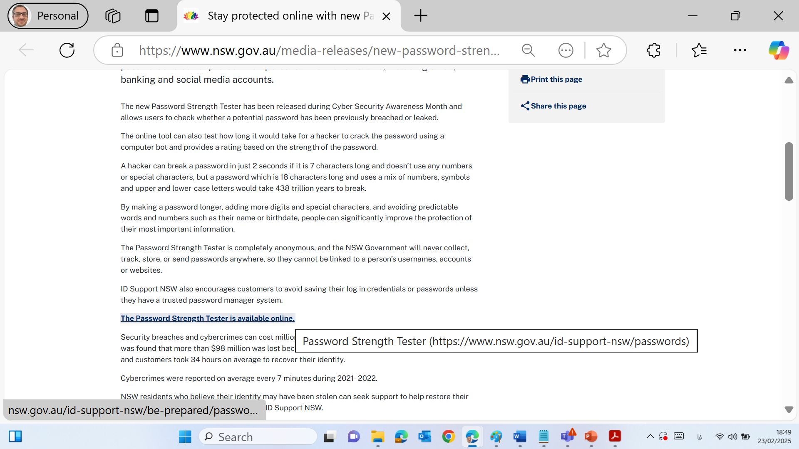
Countermeasures

Slide 55
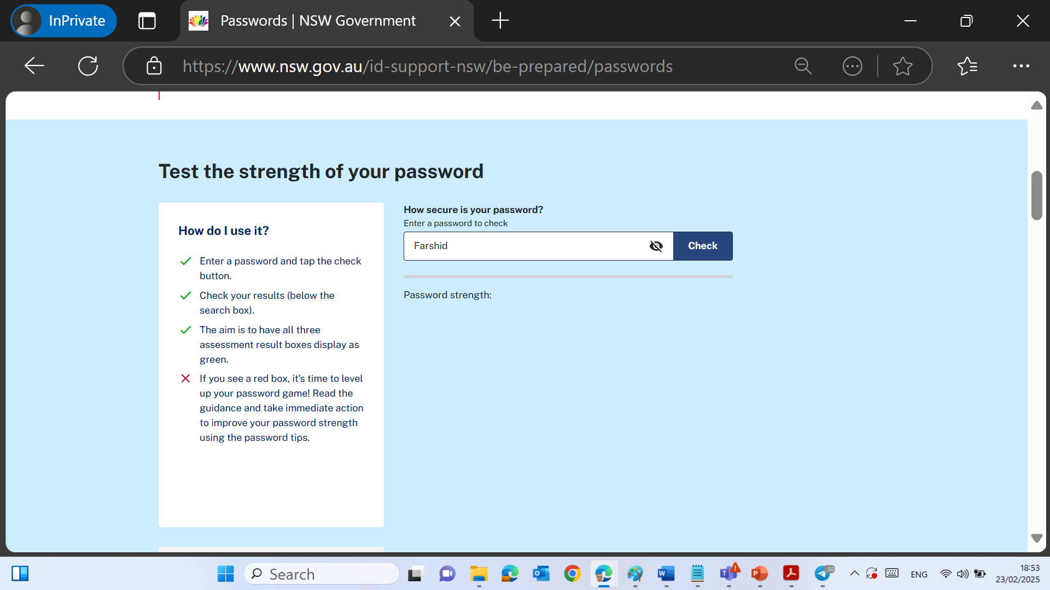
Countermeasures

Slide 56
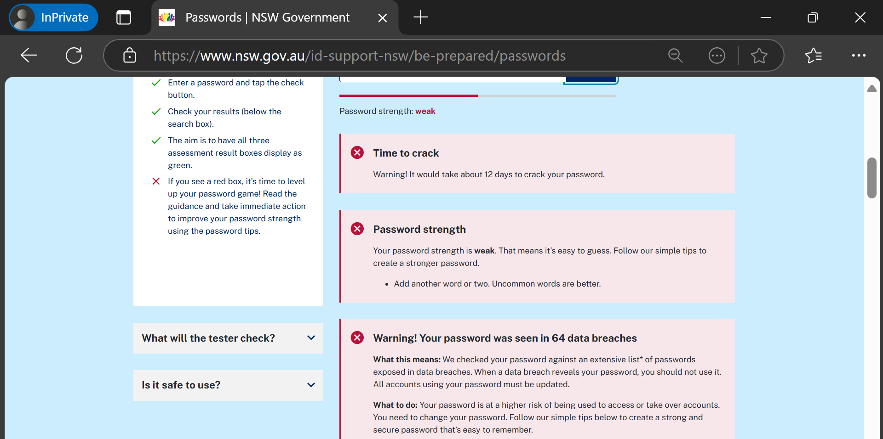
Countermeasures

Slide 57
Countermeasures
Takeaway: Strong passwords are the first defense against cyberattacks.

Slide 58
Countermeasures
Problem-Solving Question: Understanding Password Security
Scenario: You need to create a strong password for an important online account. Some websites require at least 8 characters, including uppercase letters, lowercase letters, and numbers.
Questions:
Why do longer and more complex passwords provide better security?

Slide 59
Countermeasures
Problem-Solving Question: Understanding Password Security
How does adding special characters (e.g., @, #, $) make a password even stronger?
What are some ways hackers try to guess passwords, and how can you prevent this?

Slide 60
Countermeasures
Solution:
Longer passwords = More possible combinations, making them harder to crack.
Special characters increase the number of possible choices, making passwords stronger.
Hackers use brute-force attacks (trying many passwords) and dictionary attacks (guessing common words). Using unique and random passwords reduces risk.

Slide 61
Countermeasures
Takeaway: A strong password should be long, random, and include a mix of letters, numbers, and symbols.

Slide 62
Conclusion & Next Steps
The lab sessions will start in Week 2. Please review the lab materials in advance.

Slide 63
Make-up Session
Please note that Friday, 18 April 2025 is a public holiday (Good Friday), and no classes will be held on this day.
To ensure continuity in learning, a make-up session has been scheduled one week earlier, on:
Date: Friday, 11 April 2025 Location: Room 502.G.25 Time: 4:00 PM – 6:00 PM
If you have any scheduling conflicts or concerns, feel free to reach out.

Slide 64
Thank You
Have a Great Learning Day!
Feel free to reach out with any questions!

